Slide 1
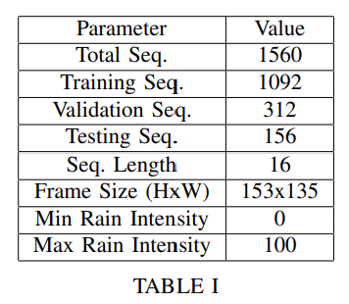
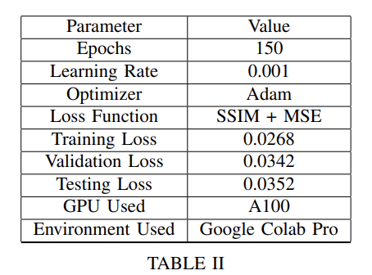
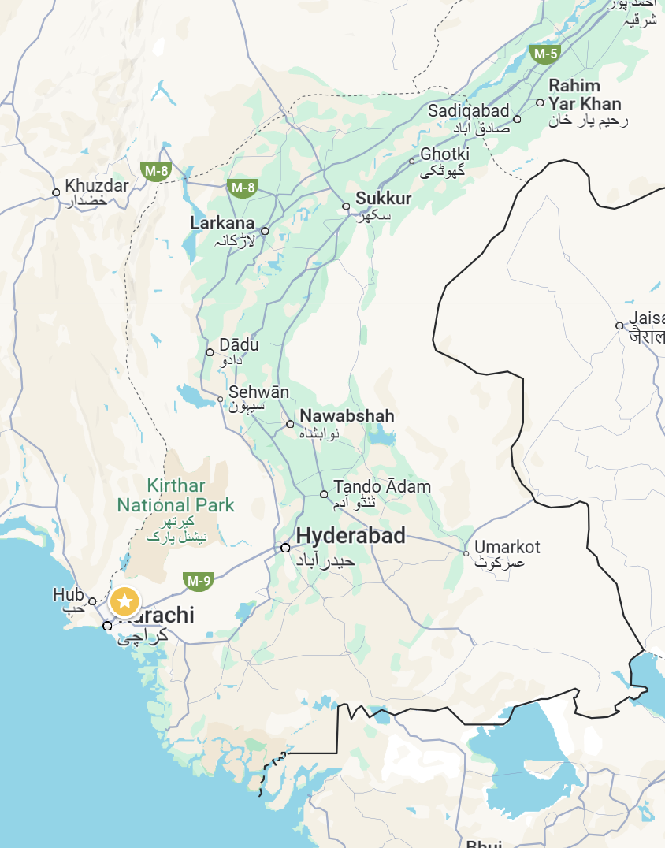
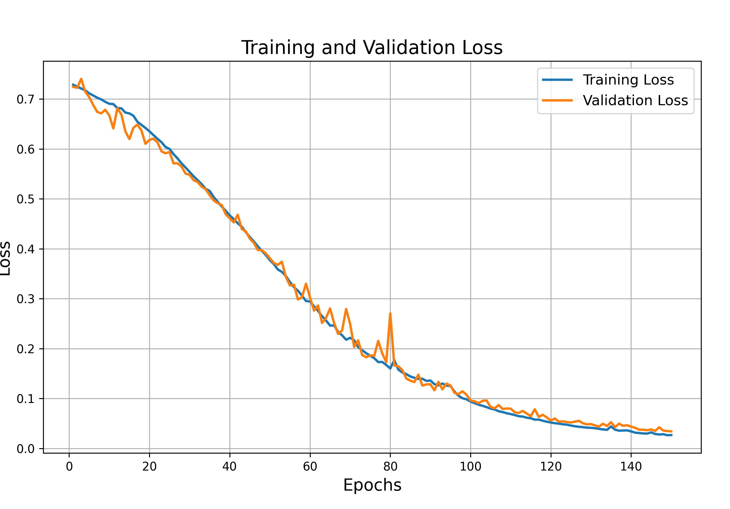
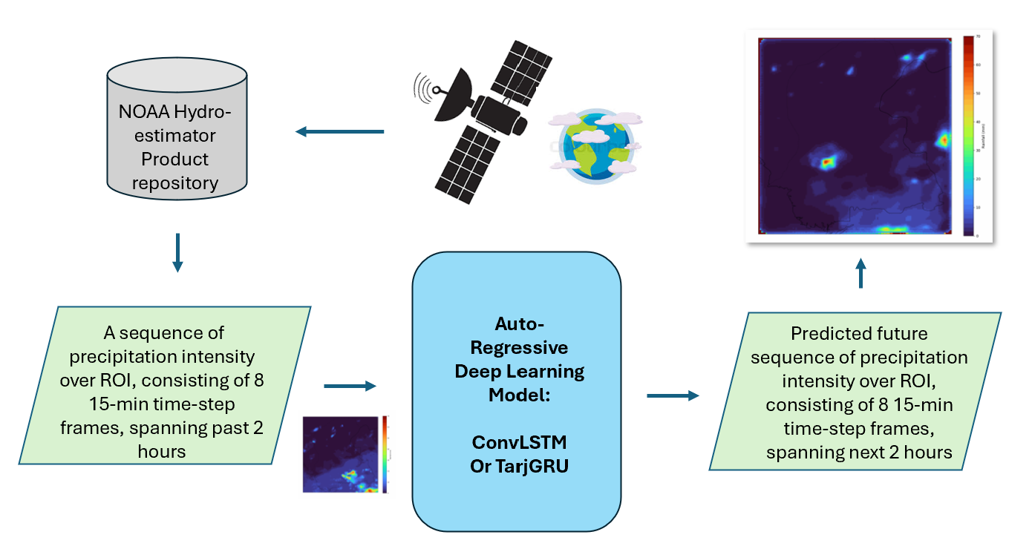
Precipitation Nowcasting Using Deep Learning
Sarwan Shah | Graduate Student, Electrical Engineering, Arizona State University
Course: EEE598 Deep Learning
Instructor: Dr. Suren Jayasuriya
Abstract— Precipitation nowcasting for short-term storm forecasting (0–6 hours) is essential for timely severe weather warnings. Traditional methods such as numerical weather prediction (NWP) and radar extrapolation, often lack accuracy at short scales and are computationally intensive. Recent deep learning models, such as ConvLSTM and TrajGRU have offered promising advances by capturing complex spatiotemporal dynamics. This paper aims to evaluate these models on satellite data, addressing the limitation posed radar’s limited global coverage, while focusing on the region of Sindh, Pakistan — a region with minimal meteorological infrastructure. Thus, by contributing towards the improvement of global nowcasting capabilities this work addresses critical forecasting needs heightened by climate change.
Our Work
Result
Testing performance on a new region: Sindh, Pakistan—a region with minimal meteorological infrastructure but strong monsoonal influence. See Fig.1
Global Relevance: utilization of satellite-based data to overcome radar's limited global coverage.
Improved prediction quality by using data with higher spatial (4km x 4km) and temporal resolution (30 min). Has not been used in existing literature thus far.
Dataset: spans Monsoon season (July – September) from 2019 to 2024 and days that have > 25mm precipitation.
Loss Function: SSIM (70%) + MSE (30%) to balance spatial prediction
What is Precipitation Nowcasting?
Dataset Details
Performance Details
It is the short-term (0–6 hours) forecasting of storm systems and is critical for timely severe weather warning, agriculture, and otherwise.
Some Cool Visualizations!
What it is the Challenge around it?
Traditional methods (Numerical Weather Prediction and Optical flow on radar/satellite data) lack accuracy at short scales and are computationally intensive
Fig. 1 Region of Interest
Fig. 2 Training and Validation Loss for ConvLSTM
Our Approach
Methodology
Using sequential deep learning models (ConvLSTM¹, TrajGRU²) for improved nowcasting using satellite data
Existing Works
Largely limited to radar data – has very limited geo-spatial extent
Performance tested only for nowcasting in specific regions
Tested with limited spatial and temporal resolution (30 min) satellite products (or datasets).
Fig. 4 Left (Target) Right (Prediction): The figure shows two prediction sequences generated by the trained model on test dataset samples
Fig.3. Methodology Outline
¹Shi, X., Chen, Z., Wang, H., Yeung, D.Y., Wong, W., & Woo, W. (2015). Convolutional LSTM Network: A Machine Learning Approach for Precipitation Nowcasting. Neural Information Processing Systems
²Shi, X., Gao, Z., Lausen, L., Wang, H., Yeung, D.Y., Wong, W., & Woo, W. (2017). Deep Learning for Precipitation Nowcasting: A Benchmark and A New Model. Neural Information Processing Systems.

